Slide 1


EAST WEST INSTITUTE OF TECHNOLOGY DEPARTMENT OF INFORMATION SCIENCE AND ENGINEERING INTERNSHIP PRESENTATION
GUIDED BY:
Dr. suresh M B
Prof & HOD Dept. Of ISE,EWIT
ARCHIT SHARMA(1EW17IS010)
KRISHNAM CHATURVEDI(1EW17IS048)

Slide 2
ABSTRACT
Web development is the work involved in developing a Web site for the Internet (World Wide Web) or an intranet (a private network).Web development can range from developing a simple single static page of plain text to complex Web-based Internet applications (Web apps), electronic businesses, and social network services. A more comprehensive list of tasks to which Web development commonly refers, may include Web engineering, Web design, Web content development, client liaison, client-side/server-side scripting, Web server security, network security configuration, ecommerce development. WordPress is a free and open-source content management system (CMS) written in PHP and paired with a MySQL or MariaDB database. Features include a plugin architecture and a template system, referred to within WordPress as Themes. WordPress was originally created as a blog-publishing system but has evolved to support other types of web content including more traditional mailing lists and forums, media galleries, membership sites, learning management systems (LMS) and online stores.

Slide 3

COMPANY PROFILE
Cosmic Skills is an online learning platform started by Azure Skynet Solution Private Limited, a leading IT training and service company of India with Endeavour to solve problems of students which they generally face while learning a new technology. Azure Skynet Solutions Pvt. Ltd. in association with ELAN & NVISION -Indian Institute of Technology, Hyderabad.

Slide 4
TECHNOLOGY
WordPress (WP, WordPress.org) is a free and open-source content management system (CMS) written in PHP and paired with a MySQL or MariaDB database.
Features include a plugin architecture and a template system, referred to within WordPress as Themes. WordPress was originally created as a blog-publishing system but has evolved to support other types of web content including more traditional mailing lists and forums, media galleries, membership sites, learning management systems (LMS) and online stores.
WordPress is used by more than 60 million websites, including 33.6% of the top 10 million websites as of April 2019, WordPress is one of the most popular content management system solutions in use.

Slide 5
WordPress was released on May 27, 2003, by its founders, American developer Matt Mullenweg and English developer Mike Little.
To function, WordPress has to be installed on a web server, either part of an Internet hosting service like WordPress.com or a computer running the software package WordPress.org in order to serve as a network host in its own right. A local computer may be used for single-user testing and learning purposes
To function, WordPress has to be installed on a web server, either part of an Internet hosting service like WordPress.com or a computer running the software package WordPress.org in order to serve as a network host in its own right .

Slide 6
PROPOSED SYSTEM
WordPress users may install and switch among different themes. Themes allow users to change the look and functionality of a WordPress website without altering the core code or site content.
Every WordPress website requires at least one theme to be present and every theme should be designed using WordPress standards with structured PHP, valid HTML (HyperText Markup Language), and Cascading Style Sheets (CSS). directly into the themes directory, for example via FTP .
These customizations range from search engine optimization (SEO), to client portals used to display private information to logged in users, to content management systems, to content displaying features, such as the addition of widgets and navigation bars.

Slide 7
WordPress users may install and switch among different themes. Themes allow users to change the look and functionality of a WordPress website without altering the core code or site content.
Every WordPress website requires at least one theme to be present and every theme should be designed using WordPress standards with structured PHP, valid HTML (HyperText Markup Language), and Cascading Style Sheets (CSS). directly into the themes directory, for example via FTP .
These customizations range from search engine optimization (SEO), to client portals used to display private information to logged in users, to content management systems, to content displaying features, such as the addition of widgets and navigation bars.

Slide 8
Why We Should Use WordPress for Our Website ?
1. WordPress is Easy to Customize with Themes and Plugins .
2. WordPress is SEO Friendly.
3. WordPress Can Handle Different Media Types.
4. Also help in - a) Starting a Blog
b) Sell online courses
c) Make a business website

Slide 9
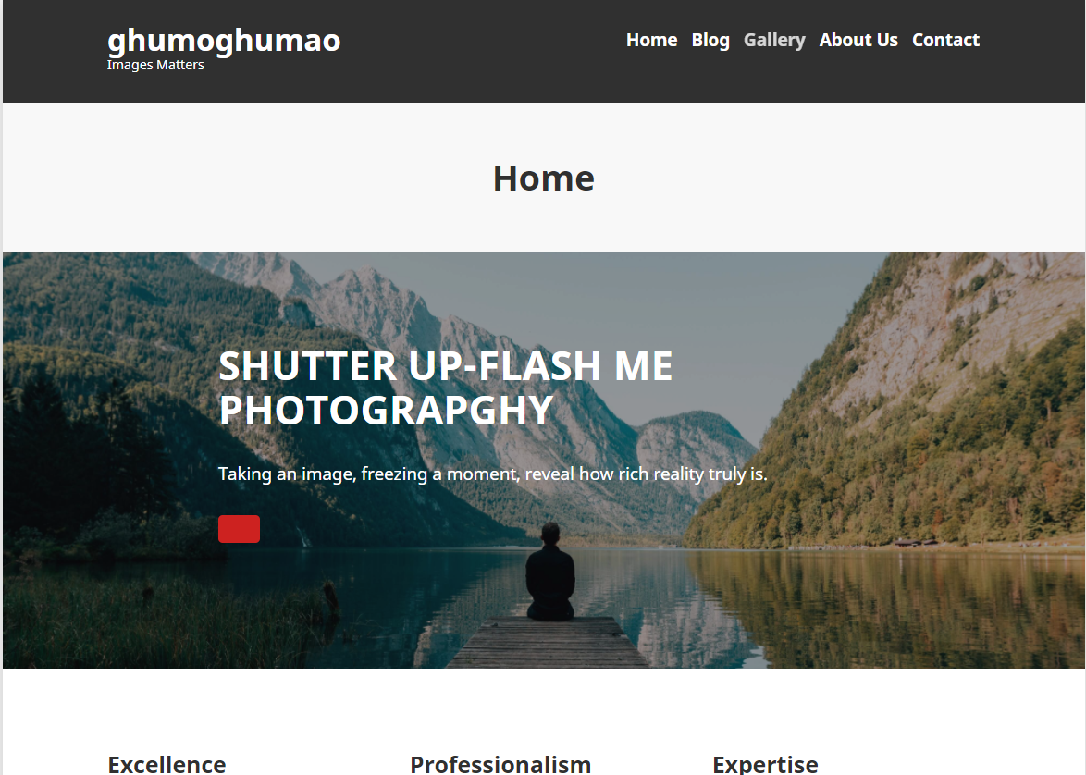
Snapshots
Snapshot 1:Home

Slide 10
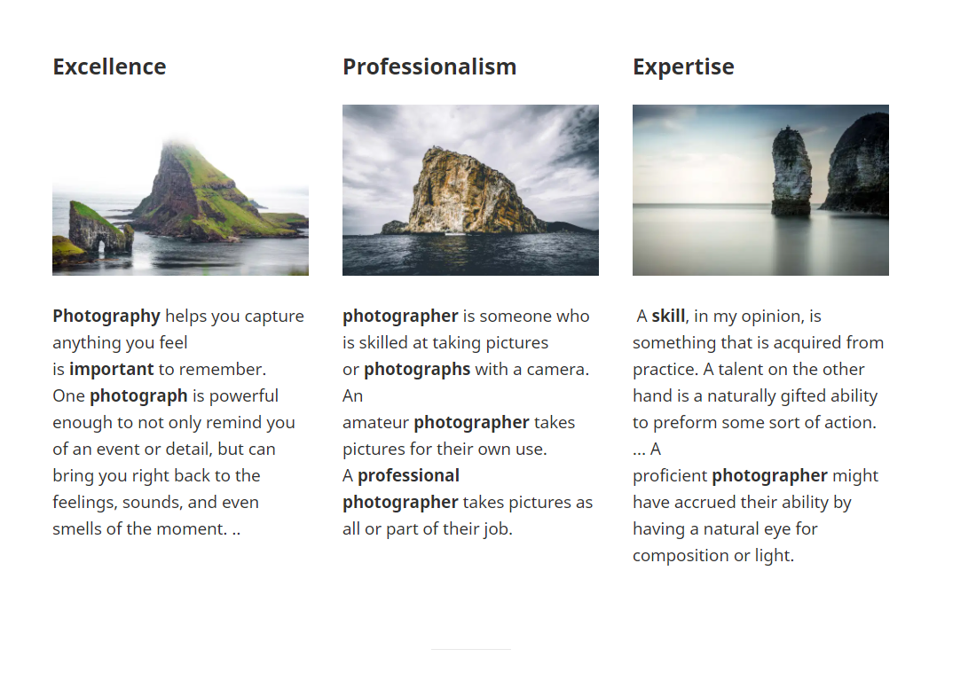
Snapshot 2:Blog Page

Slide 11
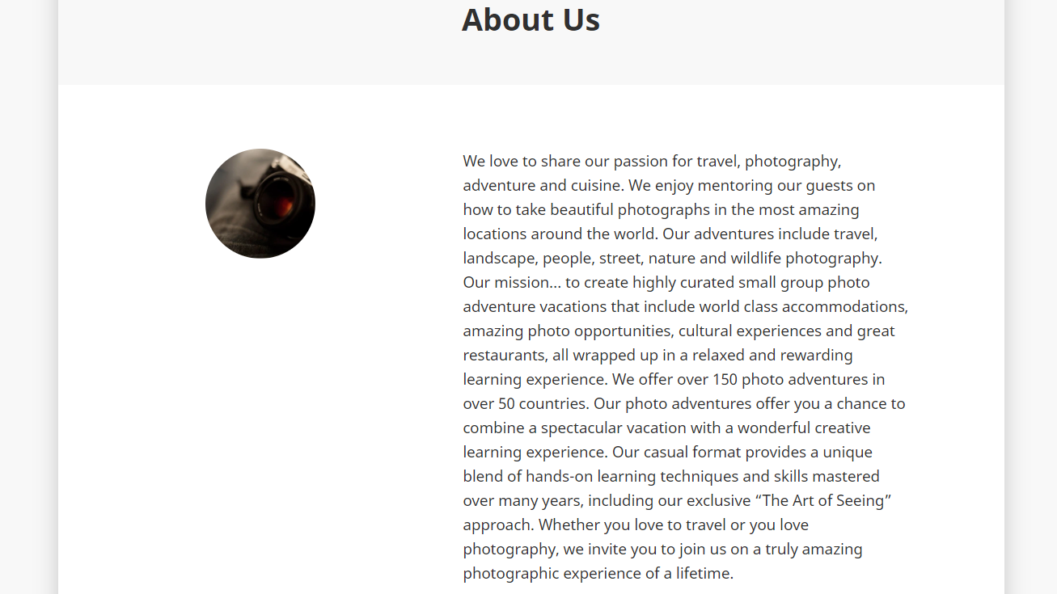
Snapshot 3:About Us Page

Slide 12
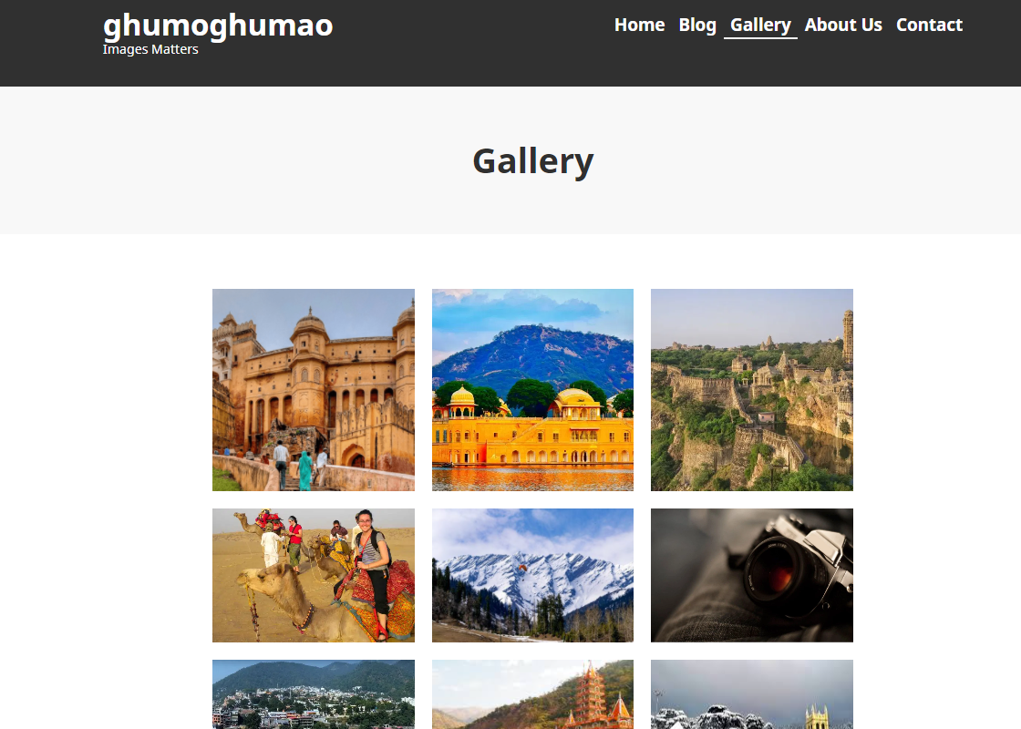
Snapshot 4:Gallery Page

Slide 13
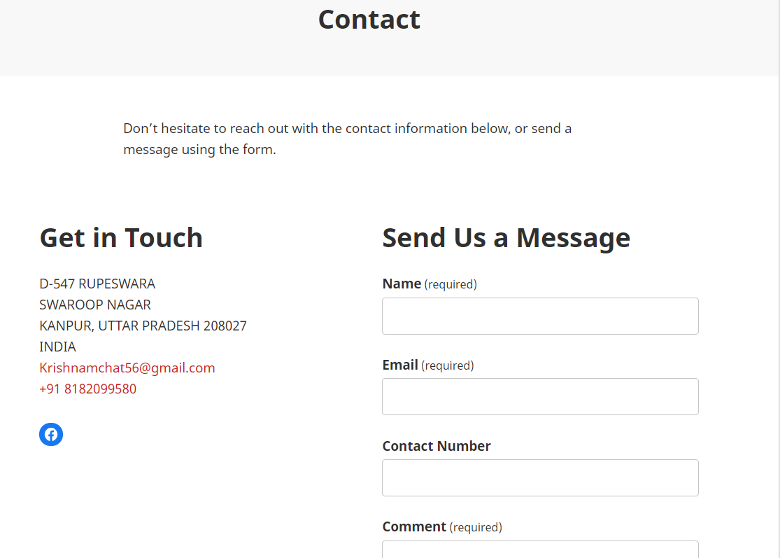
Snapshot 6:Contact Page

Slide 14
CONCLUSION
WordPress is a very good script to create a simple website.
It is one of the simplest to use (definitely not simpler than Quick.Cms though) of all solutions available on the internet.
It's very good choose for a beginner’s.
Advanced users with advanced needs would have to install many plugins to have what is a standard for Joomla or Drupal.

Slide 15
REFRENCES
www.Wikipedia.org
www.wordpress.org
www.youtube.com
www.cosmicskills.com

Slide 16
THANK YOU

